Slide 1
Continuous Delivery of Microservices: Patterns and Processes
Anders Wallgren
CTO, Electric Cloud

Slide 2
What are Microservices?
A pattern for building distributed systems:
A suite of services, each running in its own process, each exposing an API
Independently developed
Independently deployable
Each service is focused on doing one thing well
“Gather together those things that change for the same reason, and separate those things that change for different reasons.”
– Robert Martin

Slide 3
What’s cool about Microservices?
Loose coupling, so each service can:
choose the tooling that’s appropriate for the problem it solves
can be scaled as appropriate, independent of other services
can have its own lifecycle independent of other services
Makes it easier to adopt new technologies
Smaller more autonomous teams are more productive

Slide 4
Isn’t this just SOA warmed over?
SOA was also meant to solve the monolithic problem
No consensus evolved on how to do SOA well (or even what SOA is)
Became more about selling middleware than solving the problem
Tends to mandate technology stacks
Doesn’t address how to break down monoliths beyond “use my product to do it”
Microservices evolved out of real world problem solving

Slide 5
Can’t I just modularize and use shared libraries?
Technological coupling
No longer free to use the tools that are fit for purpose
Generally not able to deploy a new version without deploying everything else as well
Makes it much easier to introduce API coupling – process boundaries enforce good API hygiene
Code reuse is a good thing, but it’s not the
best basis for a distributed architecture

Slide 6
What’s good/bad about monolithic apps?
Can be easier to test
Can be easier to develop
Can be easier to deploy
Can’t deploy anything until you deploy everything
Harder to learn and understand the code
Easier to produce spaghetti code
Hard to adopt new technologies
You have to scale everything to scale anything

Slide 7

So…Was Fred Brooks Wrong?
Emphatically, no
But!
A properly constructed microservices architecture makes it vastly easier to scale teams and scale applications
https://puppetlabs.com/2015-devops-report-ppc

Slide 8
Should I use Microservices?
If you already have solid CI, automated testing, and automated deployment, and you’re looking to scale, then maybe
If you don’t have automated testing, then you should probably definitely worry about that first
You have to be (or become) very good at automated deployment, testing and monitoring to reap the benefits.
Microservices are not a magic hammer that
will make your other problems go away

Slide 9
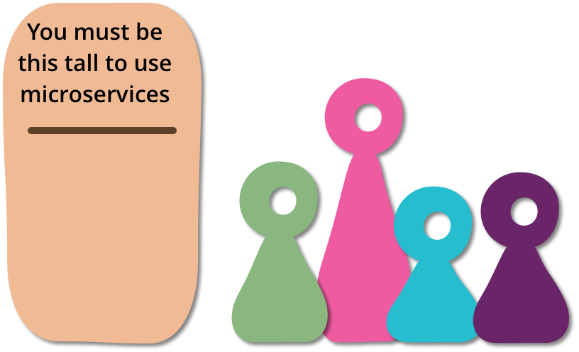
Am I ready for microservices?
If you’re just starting out, stay monolithic until you understand the problem better
You need to be good at infrastructure provisioning
You need to be good at rapid application deployment
You need to be good at monitoring
http://martinfowler.com/bliki/MicroservicePrerequisites.html

Slide 10
What’s difficult about Microservices?
Getting the service composition right is difficult
Breaking up a monolithic application takes time and will present challenges. (But it’s still worth it)
There’s more to monitor (and monitoring is much more important)
“it needs to be a cohesive system made of many small parts with autonomous lifecycles but all coming together”
- Ben Christensen, Netflix

Slide 11
Getting it done

Slide 12
What makes a good micro service?
Loose coupling
A change to service A shouldn’t require a change in service B
Small, tightly focused API
High cohesion
Each service should have a specific responsibility
Domain-specific behavior should be in one place
If you need to change a behavior, you shouldn’t have to change multiple services

Slide 13
Breaking apart the monolith
Do it incrementally, not as a big-bang rewrite. You’re going to get it wrong the first time.
Look for seams – areas of code that are independent, focused around a single business capability
Domain-Driven Design and it’s notion of Domain Contexts is a useful tool
Look for areas of code that change a lot (or needs to change)
Don’t ignore organizational structure (Conway’s Law)
Dependency analysis tools can help, but are no panacea

Slide 14
Breaking apart the monolith - Data
RDBMS may well be your largest source of coupling
Understand your schema
Foreign key constraints
Shared mutable data
Transactional boundaries.
Is eventual consistency OK?
Avoid distributed transactions if possible
Split data before you split code
Do you need an RDBMS at all or can you use NoSQL?

Slide 15
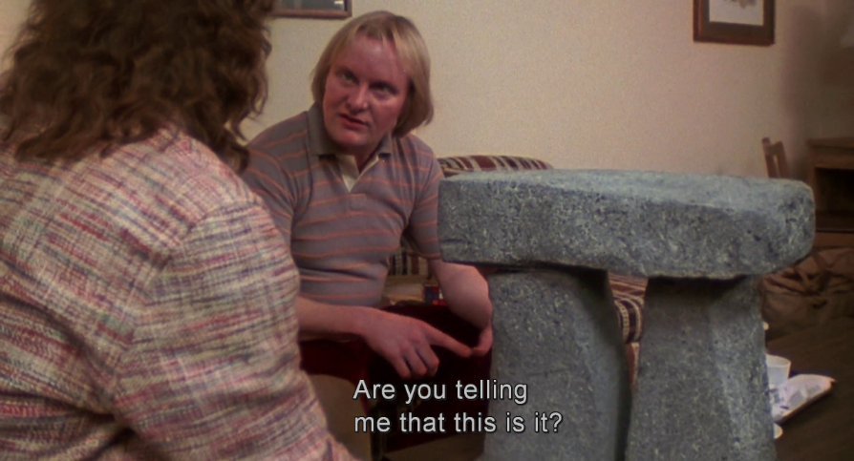

What size should my services be?
The smaller the services, the more benefit you get from decoupling
You should be able to (re-)rewrite one in a small number of weeks
If you can’t make a change to a service and deploy it without changing other things, then it’s too large
The smaller the service, the more moving parts you have, so you have to be ready for that, operationally

Slide 16
Best Practices
One repository & one CI pipeline per service
Consistent logging & monitoring output across services
You need to be rigorous in handling failures (consider using, e.g. Hystrix from Netflix to bake in better resiliency)
Avoid premature decomposition
If starting from scratch, stay monolithic, keep it modular and split things up as your understanding of the problem evolves
Consider event-based techniques to decrease coupling further
Postel’s Law: “Be conservative in what you do, be liberal in what you accept from others”

Slide 17
Testing
If you do lots of manual testing address that first
Unit testing and service-level testing (with other services stubbed or mocked)
End-to-end testing is more difficult with microservices (and tells you less about what broke)
Unit tests >> service tests >> end-to-end tests
Use mocking to make sure side-effects happen as expected
Consider using a single pipeline for end-to-end tests
Performance testing is more important than in a monolith
As always, flaky tests are the devil

Slide 18
Environments & Deployment
Keep your environments as close to production as is practical
One service per host
Minimize the impact of one service on others
Minimize the impact of a host outage
Use VMs/containers to make your life easier
“Immutable servers”
PaaS solutions can be helpful, but can also constrain you
Automate all the things!

Slide 19
MTTR or MTBF?
There is a point of diminishing returns with testing (especially end-to-end testing)
You may be better off getting really good at remediating production problems
Monitoring
Very fast rollbacks
Blue/green deployments
Canary deployments
Not all services have the same durability requirements

Slide 20
Things to look out for
Your services will evolve over time – you’ll split services, perhaps merge them, etc. Just accept that.
Reporting will need to change – you probably won’t have all the data in a single place (or even a single technology)
“The network is reliable” (and the rest of the 8 fallacies)
Be careful about how you expose your data objects over the wire

Slide 21
Monitoring

Slide 22
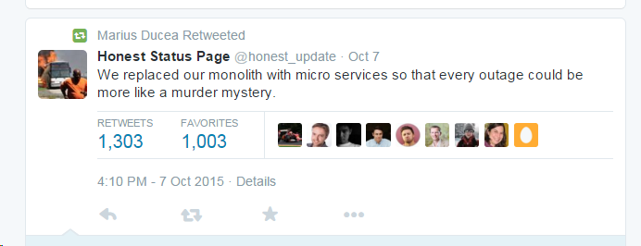
The Importance of Monitoring

Slide 23
How does monitoring change?
Monitoring a monolith is easier than microservices since you really only have one thing that can break…
With a large number of services, tracking the root cause of a failure can be challenging

Slide 24
Monitoring Best Practices
All services should log and emit monitoring data in a consistent fashion (even if using different stacks)
Monitor latency and response times between services
Monitor the host (CPU, memory, etc)
Aggregate monitoring and log data into a single place
Log early, log often
Understand what a well-behaving service looks like, so you can tell when it goes wonky
Use techniques like correlation ids to track requests through the system

Slide 25
Resources
http://www.infoq.com/presentations/Breaking-the-Monolith
http://martinfowler.com/tags/microservices.html
http://www.amazon.com/Building-Microservices-Sam-Newman/dp/1491950358
http://highscalability.com/blog/2014/7/28/the-great-microservices-vs-monolithic-apps-twitter-melee.html

Slide 26

Questions?

